Slide 1
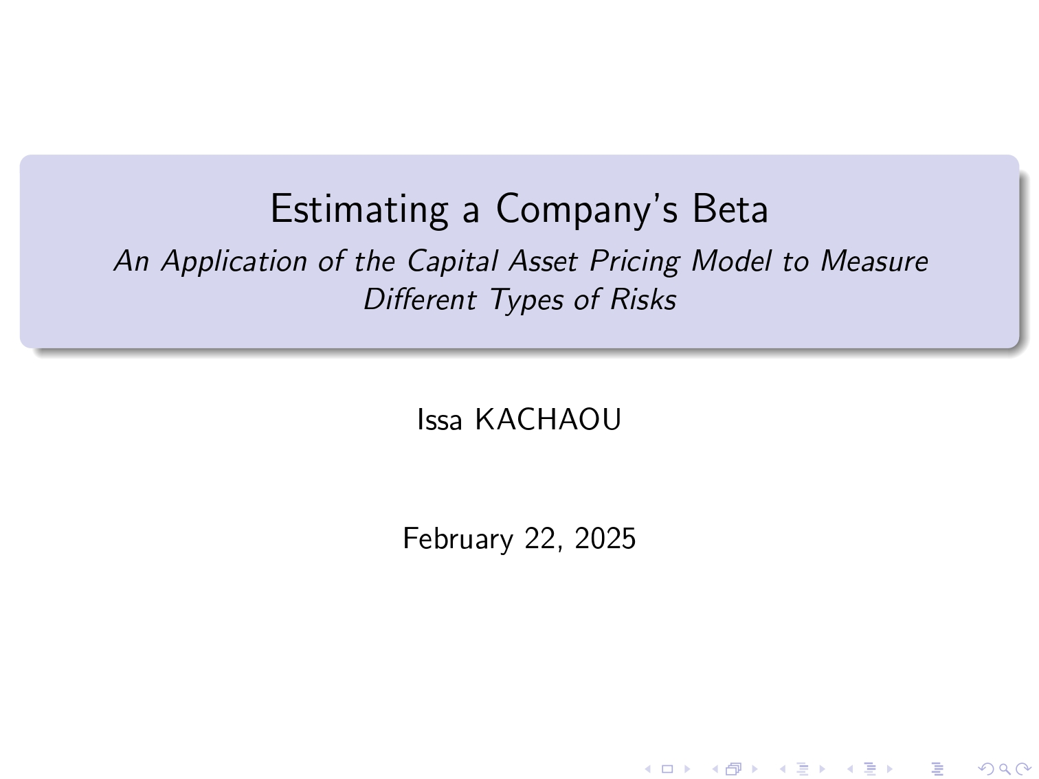
Notes:
Good morning everyone. Today, I am going to talk about an important financial concept: Beta.
Specifically, we will look at how we can estimate the beta of a company, in this case, NVIDIA, using the Capital Asset Pricing Model, or CAPM.
First, we will define what beta is and why it matters. Then, we will see how beta helps differentiate between systematic risk and idiosyncratic risk. Next, I will explain how we can estimate beta using real-world data. Finally, we will analyze the results and discuss their implications.
The goal of this presentation is to understand how beta helps investors measure risk and make informed financial decisions.

Slide 2
Notes:
Before we move on to the estimation of beta, let's take a look at some key studies that have shaped our understanding of this concept.
The Capital Asset Pricing Model, or CAPM, was developed in the 1960s by economists William Sharpe, John Lintner, and Jan Mossin. Their work established the relationship between an asset's risk and its expected return.
Later, Fama and French in 2004 critically evaluated the CAPM and introduced a multi-factor model to account for additional risk factors. While CAPM remains widely used, one of its main criticisms is that beta is not always stable over time. This means that the risk measurement for an asset can change depending on market conditions.

Slide 3
Notes:
CAPM is based on several key assumptions: markets are efficient, investors are rational and risk-averse, and all assets can be traded without restrictions. It also assumes that investors have homogeneous expectations and that there are no taxes or transaction costs, which simplifies the model but limits its real-world applicability.
While CAPM remains widely used, one of its main criticisms is that beta is not always stable over time. This means that the risk measurement for an asset can change depending on market conditions.

Slide 4
Notes:
Now, let's discuss the theoretical framework behind beta estimation. The main formula we use is the Capital Asset Pricing Model equation.
This equation tells us that the expected return of an asset depends on the risk-free rate, the market return, and the beta of the asset.
The risk-free rate represents the return of an investment with zero risk, typically government bonds. The market return is the return of a broad stock market index, like the NASDAQ. Finally, beta measures how much the asset moves in relation to the market. If beta is greater than 1, the asset is more volatile than the market. If beta is less than 1, the asset is less volatile.

Slide 5
Notes:
To estimate beta, we need real-world data. For this analysis, we use the stock adjusted prices of NVIDIA and the NASDAQ index as our benchmark.
We consider different data frequencies: daily returns and high-frequency 5-minute returns.
We then apply a statistical technique called Ordinary Least Squares regression, or OLS. This technique allows us to estimate the relationship between NVIDIA’s returns and the NASDAQ’s returns. The resulting beta coefficient tells us how sensitive NVIDIA is to market movements.

